Slide 1
Exception Handling - Throwing Exceptions
Exception handling provides a flexible mechanism for passing control from the point of error detection to a handler that can deal with the error.
When you detect an error condition, throw an exception object to signal an exceptional condition
If someone tries to withdraw too much money from a bank account
Throw an IllegalArgumentException
IllegalArgumentException exception =
new IllegalArgumentException("Amount exceeds balance");
throw exception;

Slide 2
Exception Handling
Java has a predefined set of exceptions and errors that can occur during execution
A program can deal with an exception in one of three ways:
ignore it
handle it where it occurs
handle it an another place in the program
The manner in which an exception is processed is an important design consideration

Slide 3
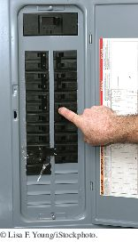
Exception Handling - Throwing Exceptions
When an exception is thrown, method terminates immediately
Execution continues with an exception handler
When you throw an exception, the normal control flow is terminated. This is similar to a circuit breaker that cuts off the flow of electricity in a dangerous situation.

Slide 4
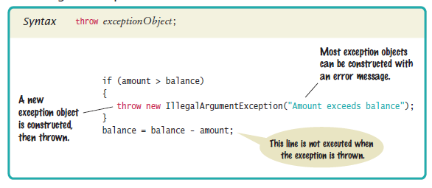
Syntax 10.1 Throwing an Exception

Slide 5
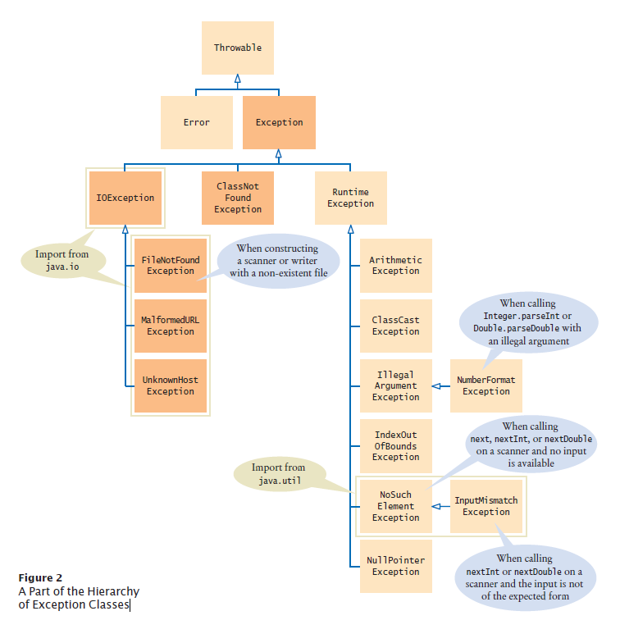
Hierarchy of Exception Classes
Figure 2 A Part of the Hierarchy of Exception Classes

Slide 6
Exception Handling
If an exception is ignored by the program, the program will terminate abnormally and produce an appropriate message
The message includes a call stack trace that:
indicates the line on which the exception occurred
shows the method call trail that lead to the attempted execution of the offending line
See Zero.java

Slide 7
Catching Exceptions
Every exception should be handled somewhere in your program
Place the statements that can cause an exception inside a try block, and the handler inside a catch clause.
try
{
String filename = . . .;
Scanner in = new Scanner(new File(filename));
String input = in.next();
int value = Integer.parseInt(input);
. . .
}
catch (IOException exception)
{
exception.printStackTrace();
}
catch (NumberFormatException exception)
{
System.out.println(exception.getMessage());
}

Slide 8
Catching Exceptions
Three exceptions may be thrown in the try block:
The Scanner constructor can throw a FileNotFoundException.
Scanner.next can throw a NoSuchElementException.
Integer.parseInt can throw a NumberFormatException.
If any of these exceptions is actually thrown, then the rest of the instructions in the try block are skipped.

Slide 9
Catching Exceptions
What happens when each exception is thrown:
If a FileNotFoundException is thrown,
then the catch clause for the IOException is executed because FileNotFoundException is a descendant of IOException.
If you want to show the user a different message for a FileNotFoundException, you must place the catch clause before the clause for an IOException
If a NumberFormatException occurs,
then the second catch clause is executed.
A NoSuchElementException is not caught by any of the catch clauses.
The exception remains thrown until it is caught by another try block.

Slide 10
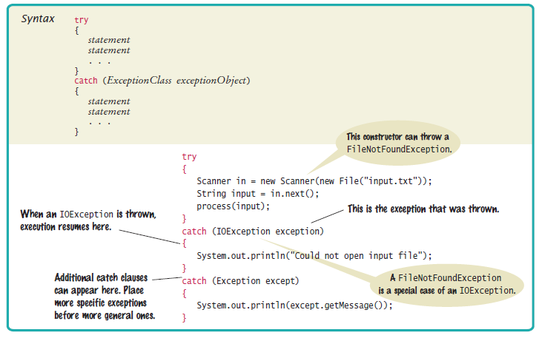
Syntax 10.2 Catching Exceptions

Slide 11

Catching Exceptions
Each catch clause contains a handler.
Our example just informed the user of a problem.
Often better to give the user another chance.
When you throw an exception, you can provide your own message string.
For example, when you call
throw new IllegalArgumentException("Amount exceeds balance");
the message of the exception is the string provided in the constructor.
You should only catch those exceptions that you can handle.

Slide 12
The try Statement
To handle an exception in a program, the line that throws the exception is executed within a try block
A try block is followed by one or more catch clauses
Each catch clause has an associated exception type and is called an exception handler
When an exception occurs, processing continues at the first catch clause that matches the exception type
See ProductCodes.java

Slide 13
Exception Propagation
An exception can be handled at a higher level if it is not appropriate to handle it where it occurs
Exceptions propagate up through the method calling hierarchy until they are caught and handled or until they reach the level of the main method
A try block that contains a call to a method in which an exception is thrown can be used to catch that exception
See Propagation.java
See ExceptionScope.java

Slide 14
Checked Exceptions
Exceptions fall into three categories
Internal errors are reported by descendants of the type Error.
Example: OutOfMemoryError
Descendants of RuntimeException,
Example: IndexOutOfBoundsException or IllegalArgumentException
Indicate errors in your code.
They are called unchecked exceptions.
All other exceptions are checked exceptions.
Indicate that something has gone wrong for some external reason beyond your control
Example: IOException

Slide 15
Checked Exceptions
Checked exceptions are due to external circumstances that the programmer cannot prevent.
The compiler checks that your program handles these exceptions.
The unchecked exceptions are your fault.
The compiler does not check whether you handle an unchecked exception.

Slide 16
Checked Exceptions - throws
You can handle the checked exception in the same method that throws it
try
{
File inFile = new File(filename);
Scanner in = new Scanner(inFile); // ThrowsFileNotFoundException
. . .
}
catch (FileNotFoundException exception) // Exception caught here
{
. . .
}

Slide 17
Checked Exceptions - throws
Often the current method cannot handle the exception. Tell the compiler you are aware of the exception
You want the method to terminate if the exception occurs
Add a throws clause to the method header
public void readData(String filename) throws FileNotFoundException
{
File inFile = new File(filename);
Scanner in = new Scanner(inFile);
. . .
}

Slide 18
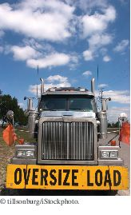
Checked Exceptions - throws
The throws clause signals to the caller of your method that it may encounter a FileNotFoundException.
The caller must decide
To handle the exception
Or declare the exception may be thrown
Throw early, catch late
Throw an exception as soon as a problem is detected.
Catch it only when the problem can be handled
Just as trucks with large or hazardous loads carry warning signs, the throws clause warns the caller that an exception may occur.

Slide 19
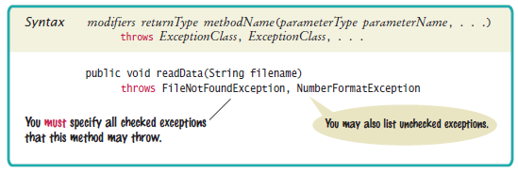
Syntax 10.3 throws Clause

Slide 20
The throw Statement
Usually a throw statement is executed inside an if statement that evaluates a condition to see if the exception should be thrown
See CreatingExceptions.java
See OutOfRangeException.java

Slide 21
The finally Clause
Once a try block is entered, the statements in a finally clause are guaranteed to be executed - whether or not an exception is thrown.
Use when you do some clean up
Example - closing files
PrintWriter out = new PrintWriter(filename);
try
{
writeData(out);
}
finally
{
out.close();
}
Executes the close even if an exception is thrown.

Slide 22

The finally Clause
All visitors to a foreign country have to go through passport control, no matter what happened on their trip. Similarly, the code in a finally clause is always executed, even when an exception has occurred.

Slide 23
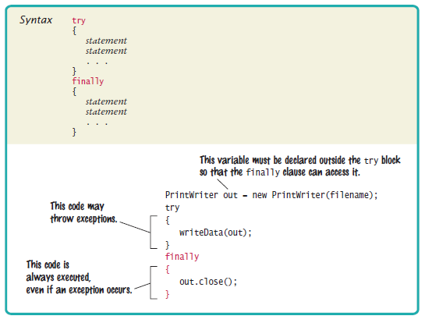
Syntax 10.4 finally Clause

Slide 24
Designing Your Own Exception Types
You can design your own exception types — subclasses of Exception or RuntimeException.
Throw an InsufficientFundsException when the amount to withdraw an amount from a bank account exceeds the current balance.
if (amount > balance)
{
throw new InsufficientFundsException( "withdrawal of " +
amount + " exceeds balance of " + balance);
}
Make InsufficientFundsException an unchecked exception
Programmer could have avoided it by calling getBalance first
Extend RuntimeException or one of its subclasses

Slide 25
Designing Your Own Exception Types
Supply two constructors for the class
A constructor with no arguments
A constructor that accepts a message string describing reason for exception
public class InsufficientFundsException extends RuntimeException
{
public InsufficientFundsException() {}
public InsufficientFundsException(String message)
{
super(message);
}
}
When the exception is caught, its message string can be retrieved
Using the getMessage method of the Throwable class.

Slide 26
Self Check 10.18
Consider the method
public static void main(String[] args)
{
try
{
Scanner in = new Scanner(new File("input.txt"));
int value = in.nextInt();
System.out.println(value);
}
catch (IOException exception)
{
System.out.println("Error opening file.");
}
}
Suppose the file with the given file name exists and has no contents. Trace the flow of execution.
Continued

Slide 27
Self Check 10.18
Answer: The Scanner constructor succeeds because the file exists. The nextInt method throws a NoSuchElementException. This is not an IOException. Therefore, the error is not caught. Because there is no other handler, an error message is printed and the program terminates.

Slide 28
Self Check 10.19
Why is an ArrayIndexOutOfBoundsException not a checked exception?
Answer: Because programmers should simply check that their array index values are valid instead of trying to handle an ArrayIndexOutOfBoundsException.

Slide 29
Self Check 10.20
Is there a difference between catching checked and unchecked exceptions?
Answer: No. You can catch both exception types in the same way, as you can see in the code example on page 518.

Slide 30
Self Check 10.21
What is wrong with the following code, and how can you fix it?
public static void writeAll(String[] lines, String filename)
{
PrintWriter out = new PrintWriter(filename);
for (String line : lines)
{
out.println(line.toUpperCase());
}
out.close();
}
Answer: There are two mistakes. The PrintWriter constructor can throw a FileNotFoundException. You should supply a throws clause. And if one of the array elements is null, a NullPointerException is thrown. In that case, the out.close() statement is never executed. You should use a try/finally statement.

Slide 31
Exception Example
public class DivideException {
public static void main(String[] args) {
division(100,4); // Line 1
division(100,0); // Line 2
System.out.println("Exit main().");
}
public static void division(int totalSum, int totalNumber) {
System.out.println("Computing Division.");
int average = totalSum/totalNumber;
System.out.println("Average : "+ average);
}
}

Slide 32
Output
Computing Division.
Average : 25
Computing Division.
java.lang.ArithmeticException: / by zero
at DivideException.division(DivideException.java:11)
at DivideException.main(DivideException.java:5)
Exception in thread "main"

Slide 33
Exception Example 2
public class DivideException2 {
public static void main(String[] args) {
int result = division(100,0); // Line 2
System.out.println("result : "+result);
}
public static int division(int totalSum, int totalNumber) {
int quotient = -1;
System.out.println("Computing Division.");
try{
quotient = totalSum/totalNumber;
}
catch(Exception e){
System.out.println("Exception : "+ e.getMessage());
}
finally{
if(quotient != -1){
System.out.println("Finally Block Executes");
System.out.println("Result : "+ quotient);
}else{
System.out.println("Finally Block Executes. Exception Occurred");
return quotient;
}
}
return quotient;
}
}

Slide 34
Output
Computing Division. Exception : / by zero Finally Block Executes. Exception Occurred result : -1

Slide 35
CS 102 – Quiz 3
// Test class continues here…..
public void b()
{
System.out.println(“5");
c();
System.out.println(“6");
}
public void c()
{
int numerator = 10, denominator = 0;
System.out.println(“7");
int result = numerator / denominator;
System.out.println(“8");
}
}
public class Prop
{
static public void main (String[] args)
{
Test demo = new Test();
System.out.println(“1");
demo.a();
System.out.println(“2");
}
}
public class Test
{
public void a()
{
System.out.println(“3");
try{
b();
} catch (ArithmeticException problem)
{
System.out.println ("The exception message is: " + problem.getMessage());
}
System.out.println(“4");
}

Slide 36
Answer
1
3
5
7
The exception message is: / by zero
4
2

